Slide 1


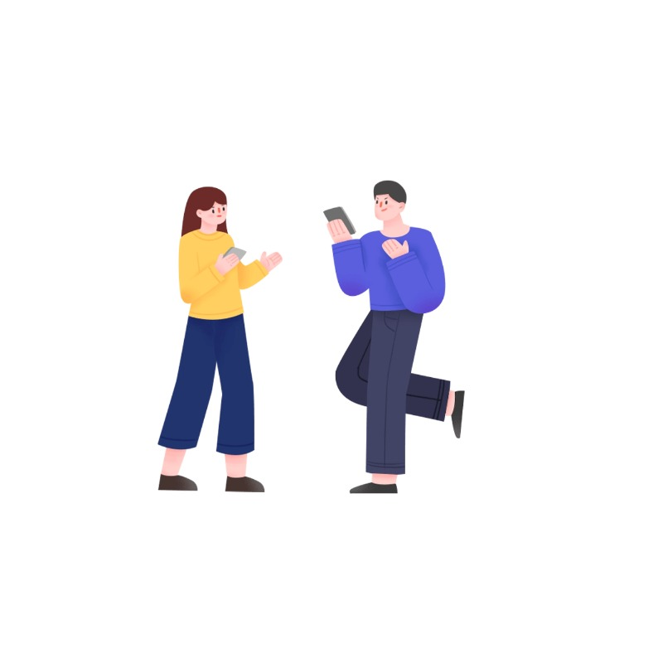








Chinese Pinyin
a
o
e

Slide 2







Introduction to Chinese Language
Pinyin
Tones
Nǐ hǎo
Pinyin
Finals
(vowels)
Pinyin
Initials
(consonants)
你 好
Chinese
Characters
you
good
With 4 elements

Slide 3

1. The simple final “a”
a
Introduction to
Simple Finals

Slide 4

Let’s read the Tones
5
5
4
4
á
ā
3
3
2
2
1
1
5
5
4
ǎ
4
à
3
3
2
2
1
1

Slide 5

Use them in words
mā
妈 mum

Slide 6
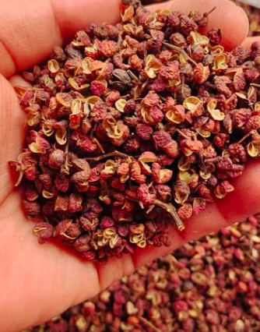
Use them in words
má
麻 num

Slide 7
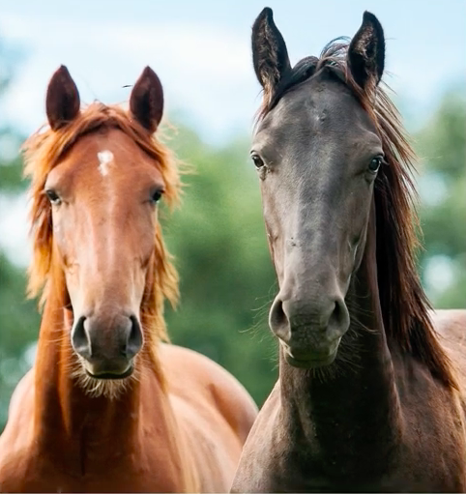
Use them in words
mǎ
马 horse

Slide 8
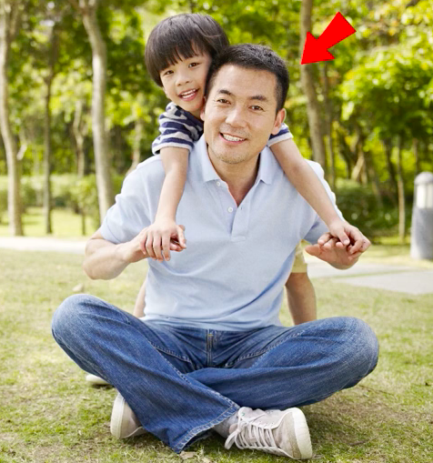
Use them in words
bà
爸 father

Slide 9
2. The simple final “o”
o
Introduction to
Simple Finals

Slide 10
Let’s read the Tones
5
5
4
ō
ó
4
3
3
2
2
1
1
5
5
ǒ
Chinese
Characters
4
4
ò
3
3
2
2
1
1

Slide 11

Use them in words
bō lí
玻璃 glass

Slide 12
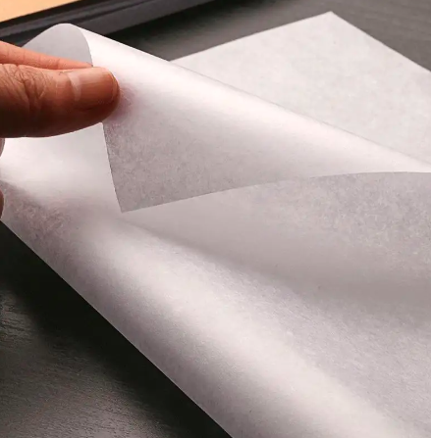
Use them in words
bó
thin薄

Slide 13

3. The simple final “e”
e
Introduction to
Simple Finals

Slide 14
Let’s read the Tones
5
5
ē
é
4
4
3
3
2
2
1
1
5
5
Chinese
Characters
4
ě
4
è
3
3
2
2
1
1

Slide 15
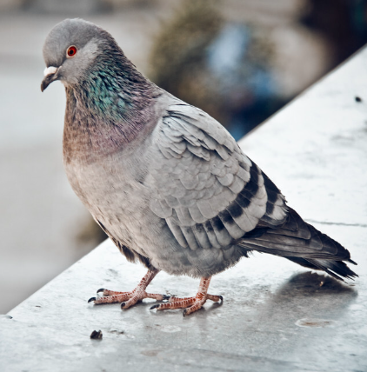
Use them in words
gē zi
鸽子

Slide 16
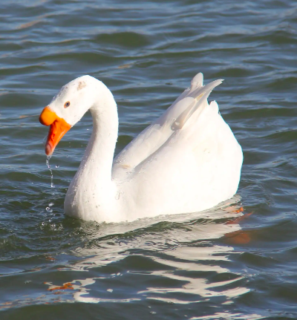
Use them in words
é
鹅goose

Slide 17
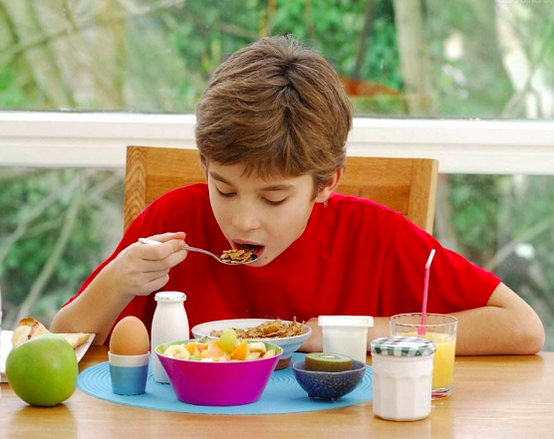
Use them in words
è
饿 hungry

Slide 18



Let’s listen and repeat

Slide 19
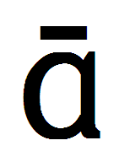
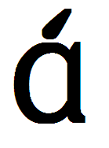

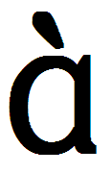
Listen and repeat

Slide 20
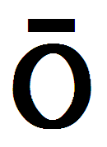
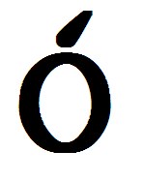
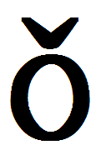
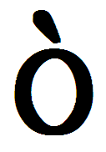
Listen and repeat

Slide 21
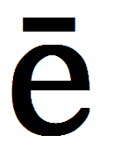
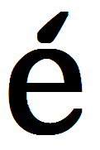
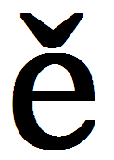
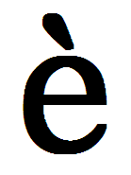
Listen and repeat

Slide 22

Chinese Pinyin
再见

